Slide 1

HAL9001
A Bot That Plays Better Than its Creators

Slide 2

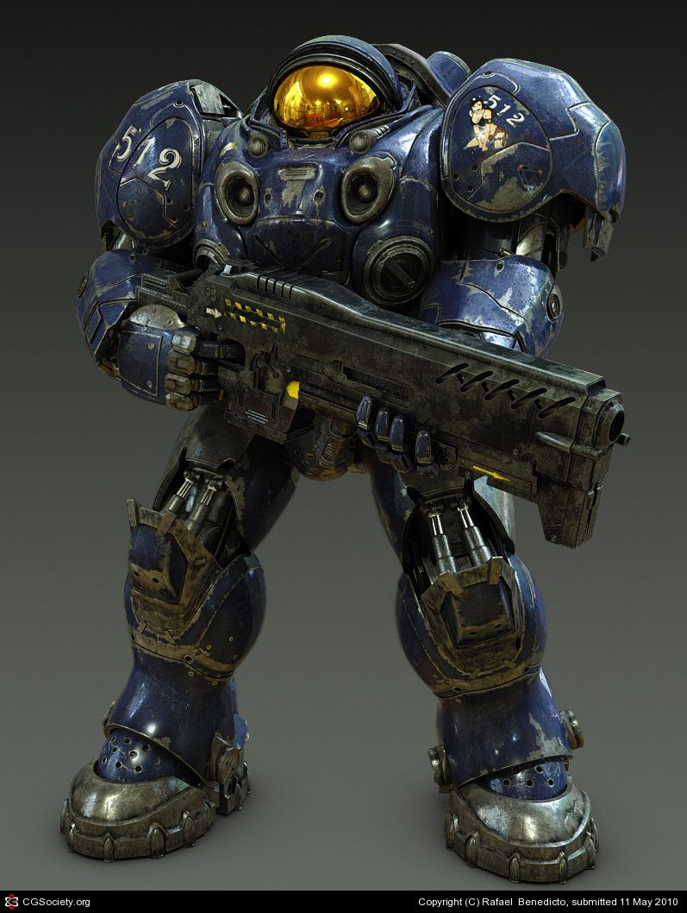
Motivations and Prior Work
Rule-based AI
Emulate a concise Terran build order for a Starcraft beginner
HuShang’s build order (source)
Elite level built-in AI

Slide 3
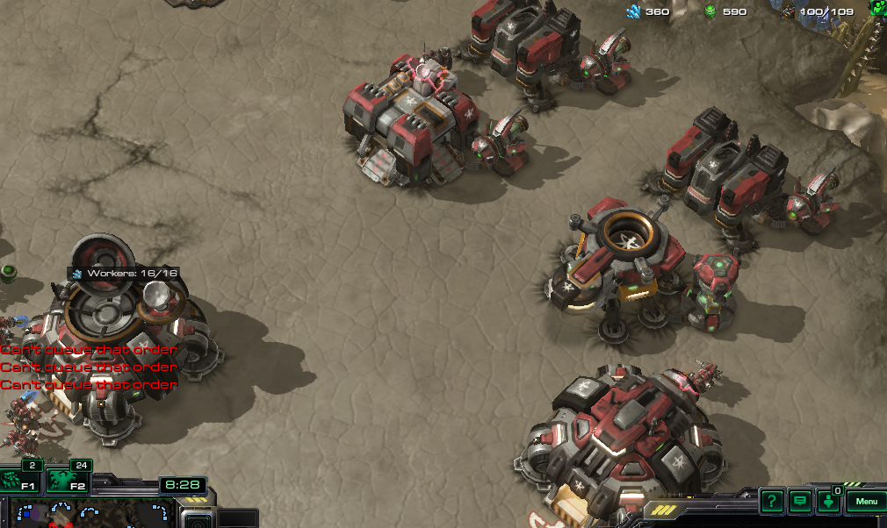
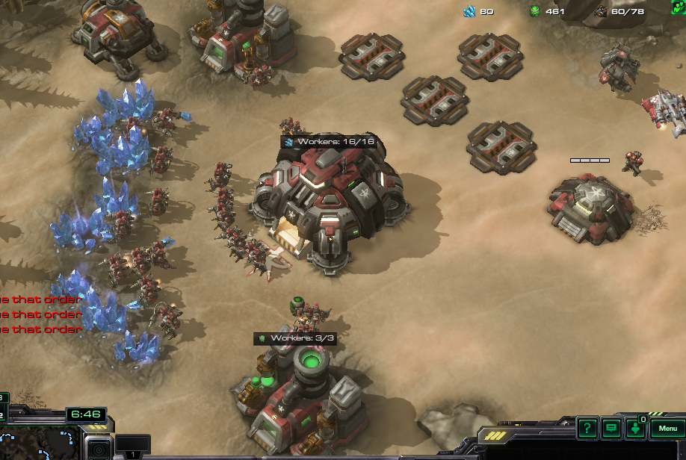
Build Order Strategy
Focus on economy
Expansion
3 barracks, 1 starport, 1 factory, 1 engbay

Slide 4
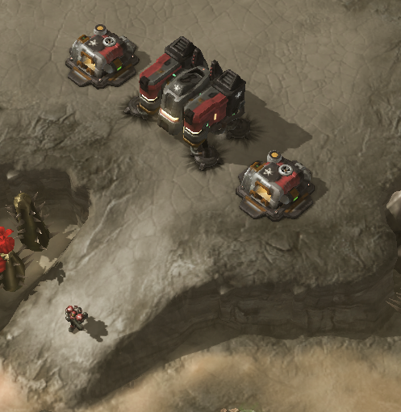
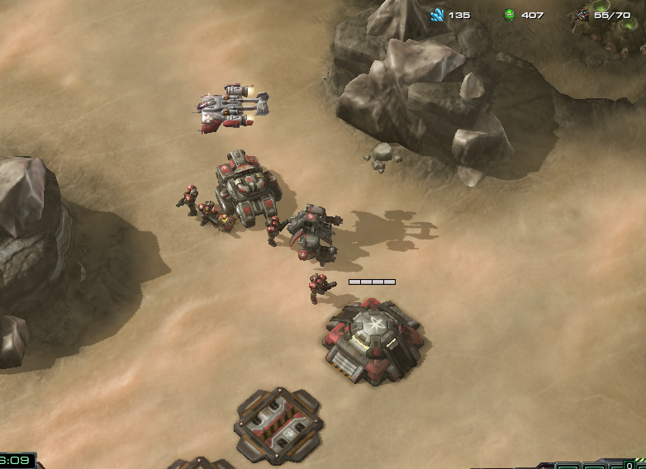
Defense Strategy
Wall-in on ramp leading to main base
Defense units: widow mine and bunker
Place army units in front of our expansion towards center of the map

Slide 5
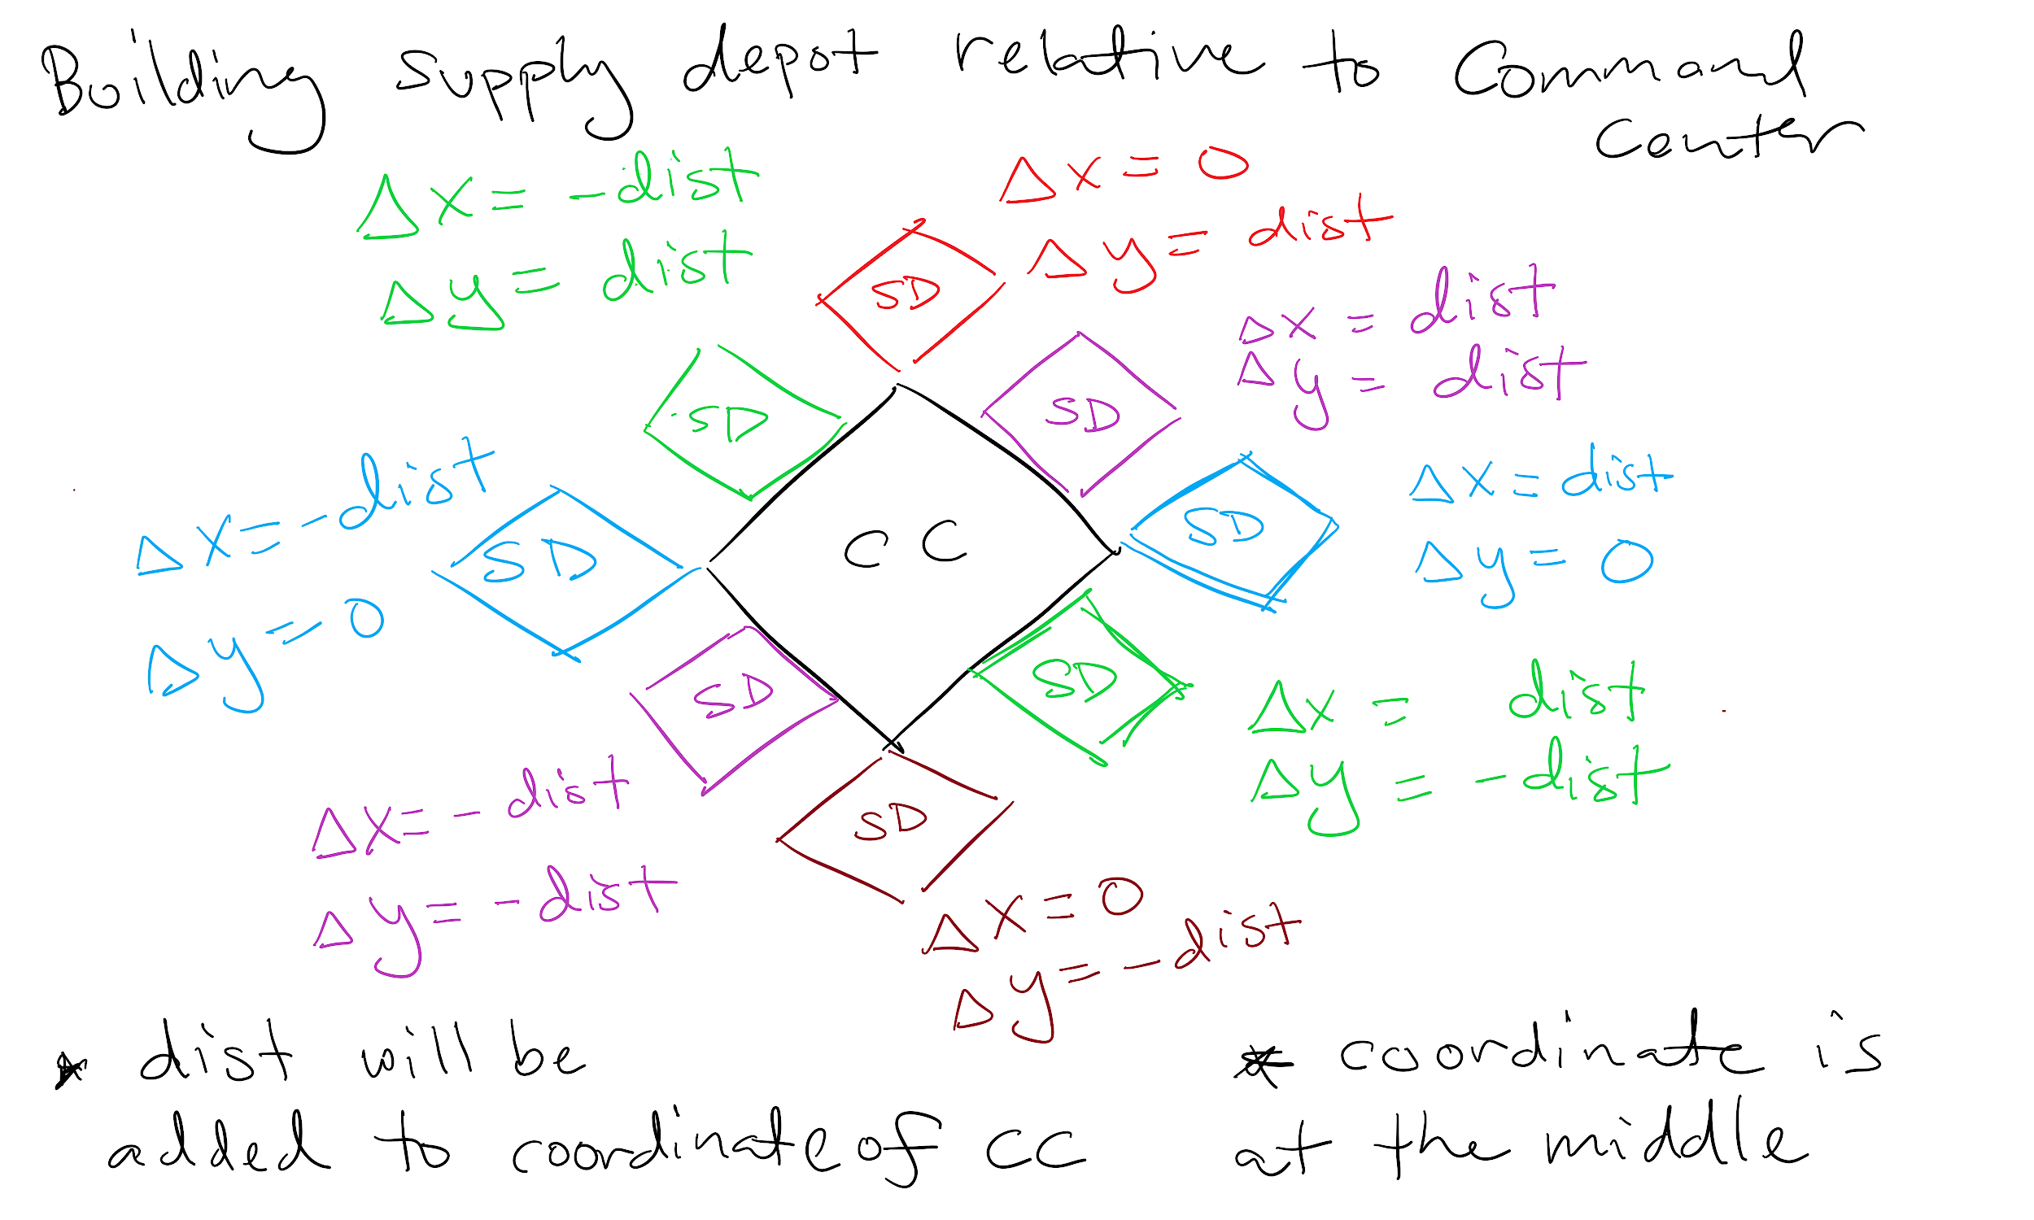
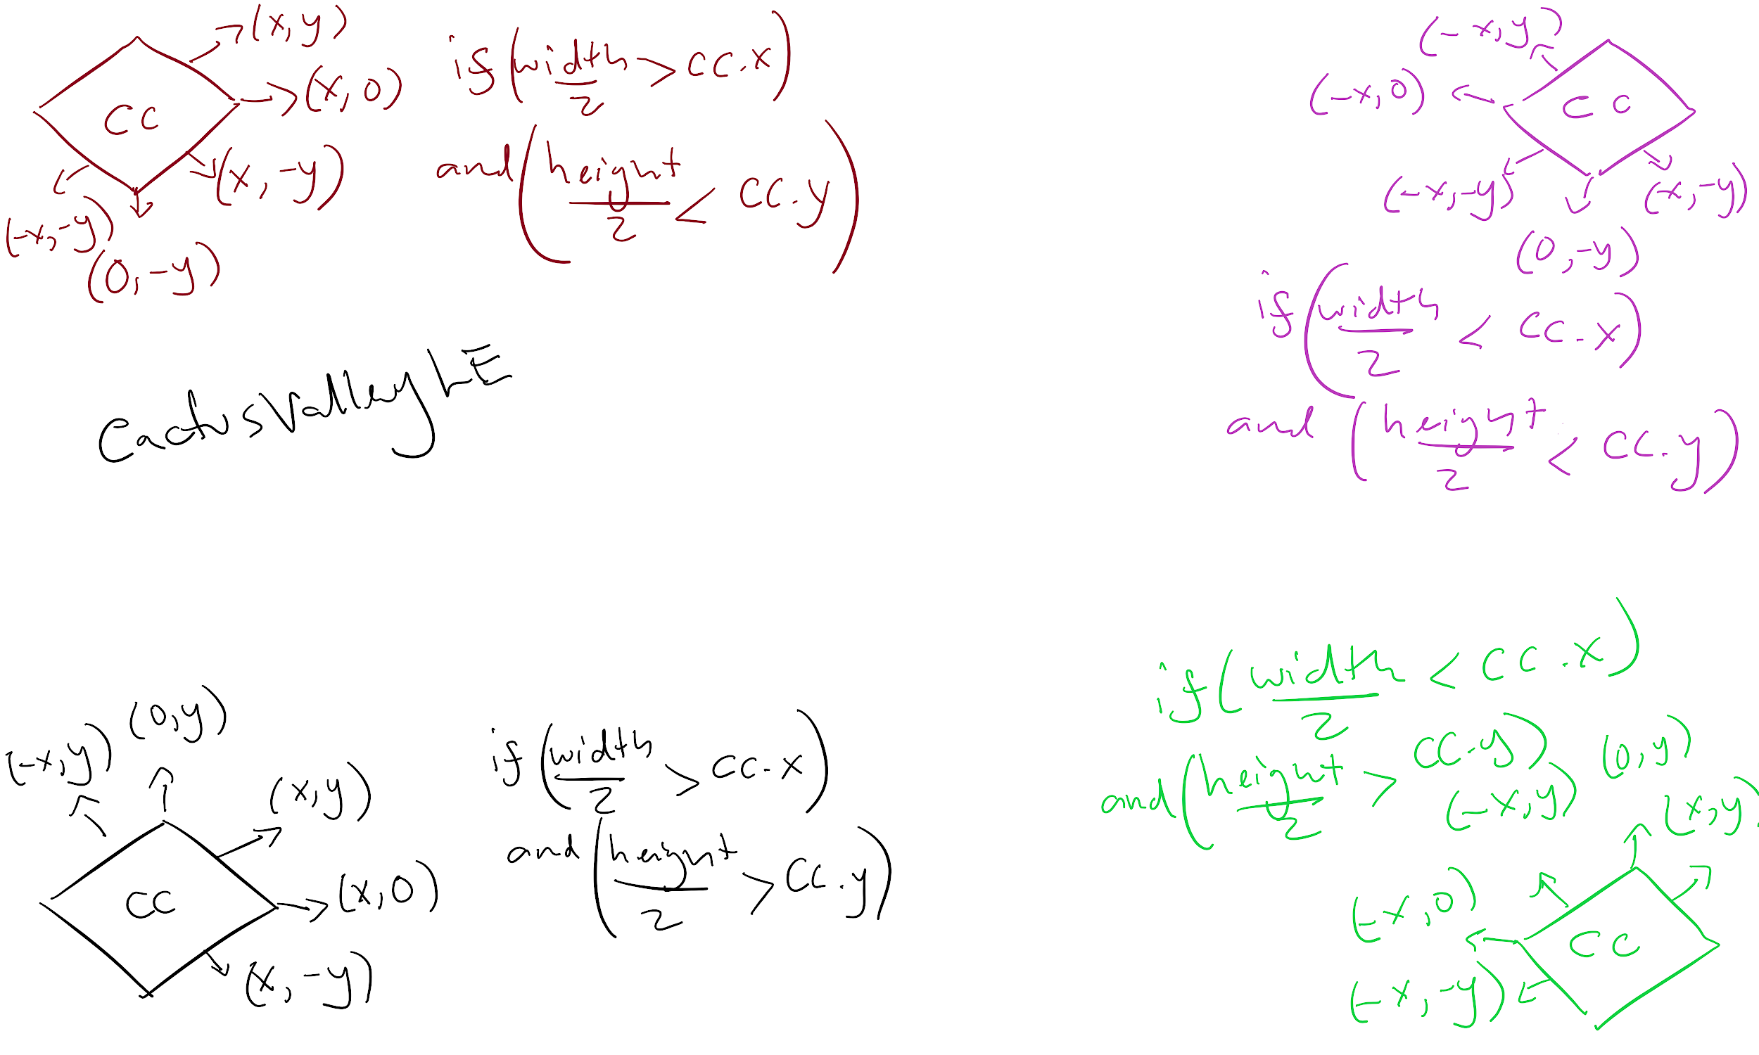
Our Approach - Build Order
Functions for managing SCV training, managing idle SCVs, managing refineries, and for completing the build order
Helper functions that can build structures relative to its position in the map
Utilizing and manipulating SC2API’s already existing functionality to get the dimensions of the structures to be built
Notes:
[Isaias]
SC2API did not have many built in functionalities to use for our purposes
get the radius of buildings before they were built, get which corner in the map the base is, get which of the 8 directions (N E S W NE …) can another structure be placed, get if an order is already given
radius => solution: get footprint_radius of ABILITY ID
corner => solution: get the half value of map width and height and compare start location x and y
relative building => FRONT, BEHIND, LEFT, RIGHT …. and placement query
is ordered => iterating over units vector and searching for corresponding ability id
we made visuals to guide us while we are coding ( we find out how to configure x and y )
more details in the github README (usability in case we get back working on it after sem)

Slide 6
Attack Strategy
Research infantry weapons level 1, combat shield, and stimpack before rushing
5:2:2:1:1 ratio of units (marines, marauders, medivacs, tanks, vikings)
Target expansions (if any) then move to main base
Use the game’s automatic targeting for what units to prioritize during attack
Retreat if our army is significantly damaged-
Notes:
The attack strategy given by the build order is a timing attack, we research some upgrades towards the end of the build order, then perform a rush once our upgrades are complete

Slide 7
Our Approach - Attack and Defense
Movement is handled independently of attack
Switch case so each unit’s attack patterns can be individually applied
Hierarchy of orders (Retreat > Rush > Defend > Gather)

Slide 8

Pros
Cons
Simple to understand
Easy to modify
Good general strategy
Solid economy for expansion
Defense of resources
Continuous training
Does not respond to specific strategies
Has a hard time recovering from early setbacks
Notes:
Pros:
Once expansion is complete, it allows for an ample reserve of resources for the player
once training structures are built units are trained right away to provide defense to currently building structures
trains as frequently as possible to build up terran army

Slide 9

Goals:
Main goal was to beat the hard built-in AI
Achieve victory consistently with minimal state management.
Be able to run real-time (in terms of efficiency) in the context of modern PC hardware.
Notes:
[Isaias]
Without much knowledge of sc2 it was hard for us to judge achievable goals
our main goals is to beat the the hard built in sc2 ai, of course we can branch out fight other made bots but we want to be consistent on the basics first
we want our bot to be as efficient as possible countering enemy bot attacks and quickly as possible.

Slide 10

Stats against built-in AI
Easy: 100% win rate
Medium: 100% win rate
Hard: 60% win rate
Very Hard : 0% win rate
* tested against each difficulty 20 times on CactusValleyLE map
Notes:
[Isaias]
currently we have tested more than 20 times for each difficulty. we want consistency
adjusting for more strategic attack and defense to achieve 100% win rate.
we only tested on zerg as to test our defenses against early zerg attacks (their typical strategy)

Slide 11
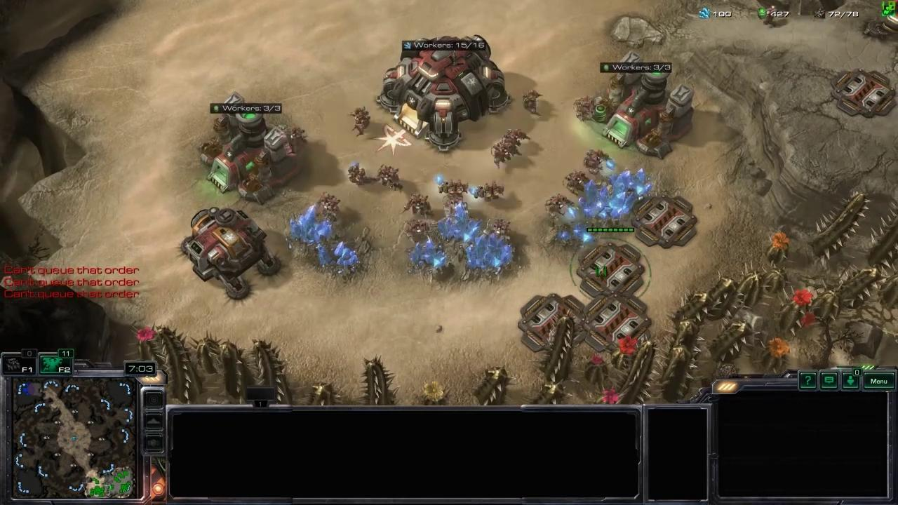
Video Demonstration

Slide 12
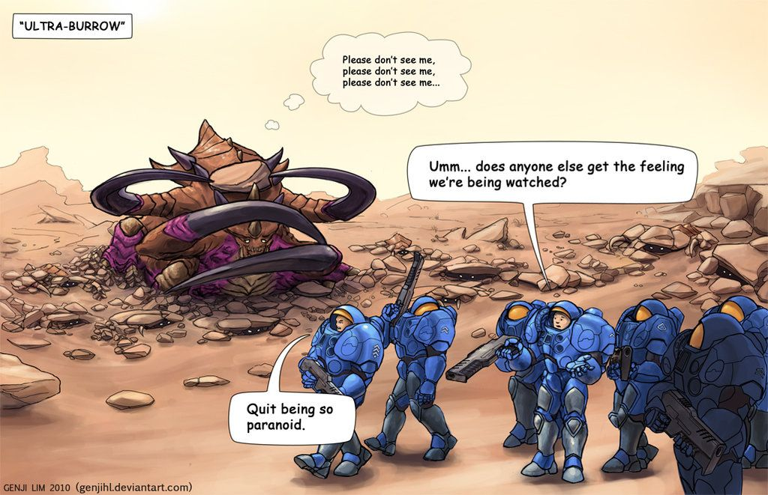
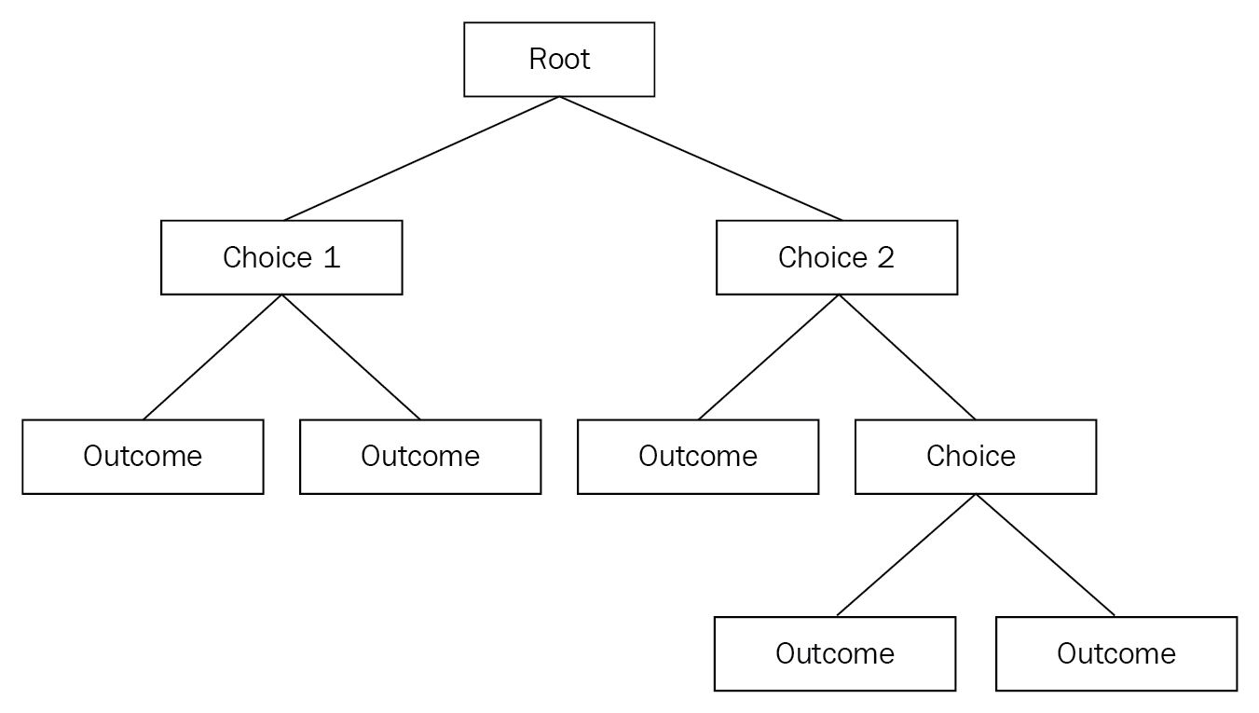
Future Work
More testing on the other maps
Implement behaviour trees rather than a finite state machine through if statements.
Implement more complicated but more powerful professional-level build ordering.
Have more varied responses

